Slide 1
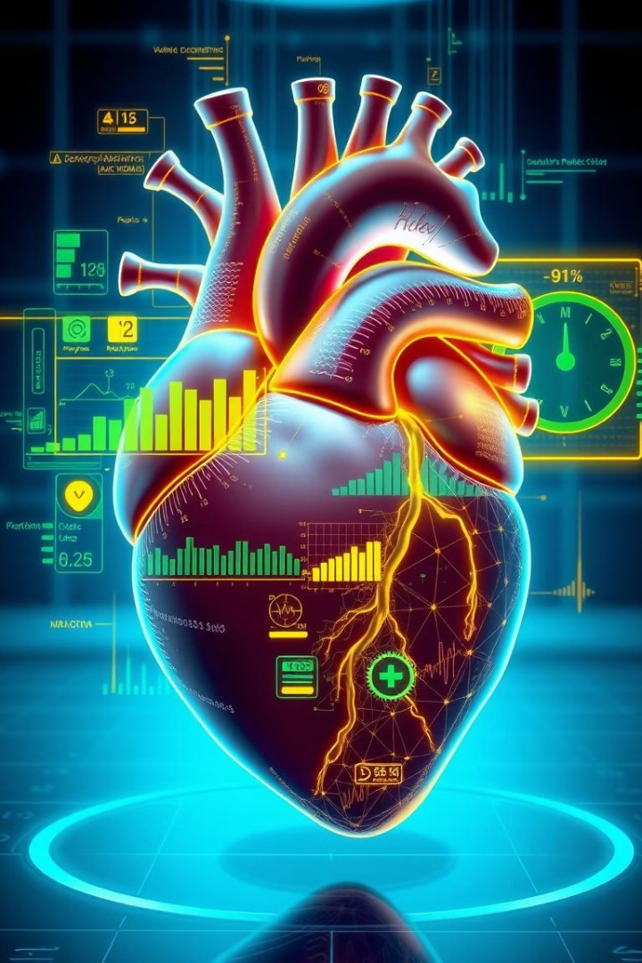
Predicting Heart Disease: A Data-Driven Approach
Cardiovascular disease causes 17.9 million deaths yearly worldwide.
Early prediction is vital for prevention and effective treatment.
Data science offers powerful tools for assessing heart disease risk.

Slide 2

Understanding the Risk Factors
Modifiable Risks
Non-Modifiable Risks
Financial Impact
Smoking, obesity, hypertension, high cholesterol, diabetes
Age, sex, family history, genetic factors
CDC reports $216 billion spent on heart disease in 2018.

Slide 3

Data Collection and Preparation
Key Datasets
Important Features
Framingham Heart Study, CDC, WHO data sources
Age, BMI, blood pressure, cholesterol, smoking status
Data Challenges
Cleaning, transforming, handling missing or inaccurate data

Slide 4
Machine Learning Models
Logistic Regression
Random Forest
Gradient Boosting Machines
Neural Networks
Ensemble method, handles complexity and feature importance
Deep learning with potential for large dataset performance
Simple, interpretable baseline model for classification
High accuracy using models like XGBoost

Slide 5

Model Building and Training
Data Split
Training (70%) and testing (30%) datasets
Cross-Validation
Minimizes overfitting through repeated sampling
Hyperparameter Tuning
Optimizes algorithm performance
Regularization
Prevents model from fitting noise

Slide 6





Model Evaluation and Metrics
Accuracy
Precision & Recall
ROC & AUC
Sensitivity
Overall correct predictions
Measure trade-off performance visually
High true positive rate to catch at-risk patients
Balance true positives and false alarms
Example: 90% accuracy with 85% sensitivity and 92% specificity.

Slide 7

Results and Interpretations
Top Predictors
Feature Importance
Insights
High cholesterol, hypertension, smoking
Identifies influential factors for risk assessment
Data aids healthcare and patient decision-making

Slide 8




Conclusion and Future Directions
Promises of ML
Diverse Data
1
Improves early heart disease prediction accuracy
Integrate genetics, lifestyle, and environment data
2
Continuous Update
4
Personalization
Refine models with ongoing data monitoring
3
Tailor risk tools to individual profiles
Future focus is on personalized, real-time, and accurate predictions.

